Slide 1
Jan-Gys Malan
SMS design Part 2

Slide 2
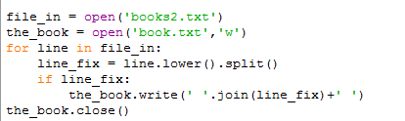
SMS Assignment Part2
The first step is to normalize the input

Slide 3
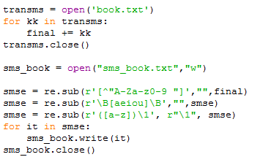
Next step
Next the text has to be edited into the desires SMS format

Slide 4

Create the dictionary
The dictionary is used to search and replace SMS words back into proper English
The .split() returns a list which can easily be read into dictionary
The update function only adds a single entry for every word.
No repetitions....good and bad.

Slide 5
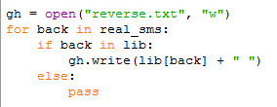
Search and replace
Read the SMSed file, and for every word in the file it searches for the corresponding
English word in the dictionary.
Problems: bat = bt
But = bt
Python will replace the “bt” with the either “bat” or “but” depending on which one was
entered into the dictionary first.

Slide 6

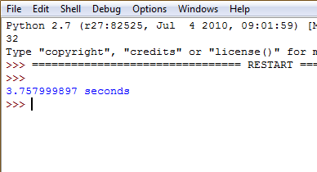
Time!

Slide 7
DEMO

